Slide 1
HTML 5 and the Canvas Element
Jason Sanchez

Slide 2
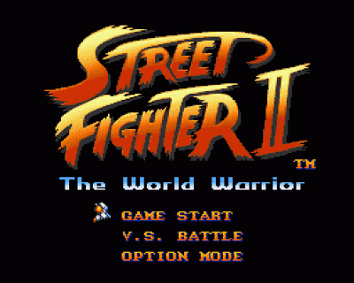
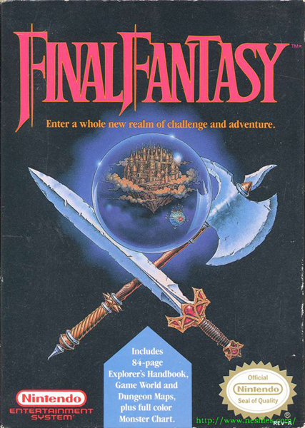
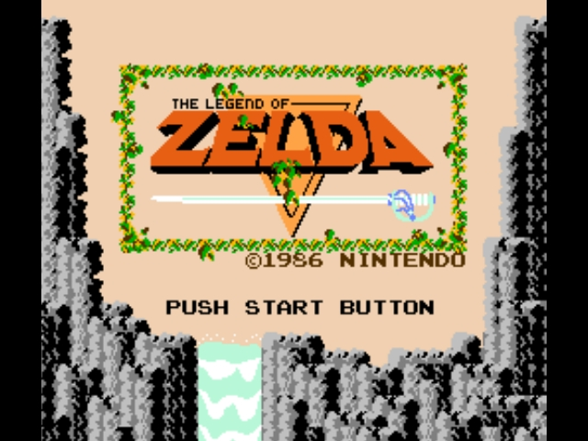
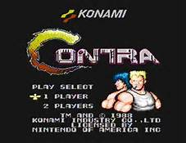
Growing Up…

Slide 3
I Searched…

Slide 4

HTML5
<canvas> Element
The HTML5 <canvas> element is an element that is used to draw graphics, via scripting (usually JavaScript).
The <canvas> element is only a container for graphics.
The used script actually draws the graphics.
Canvas has several methods for drawing paths, boxes, circles, text, and adding images.

Slide 5
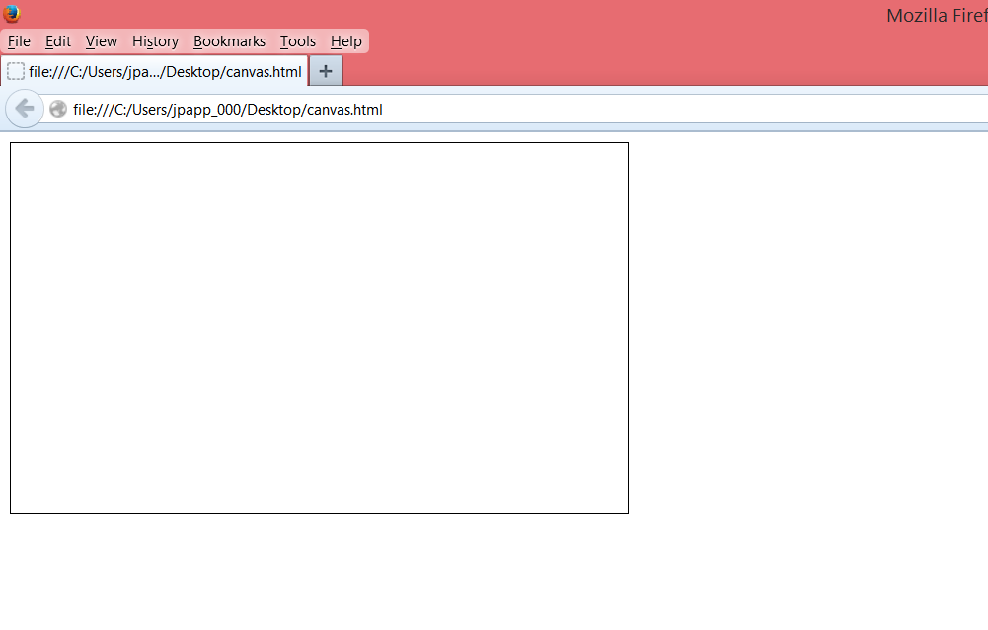
The Canvas
<canvas id="myCanvas" width=“500" height=“300"
style="border:1px solid #000000;">
</canvas>

Slide 6
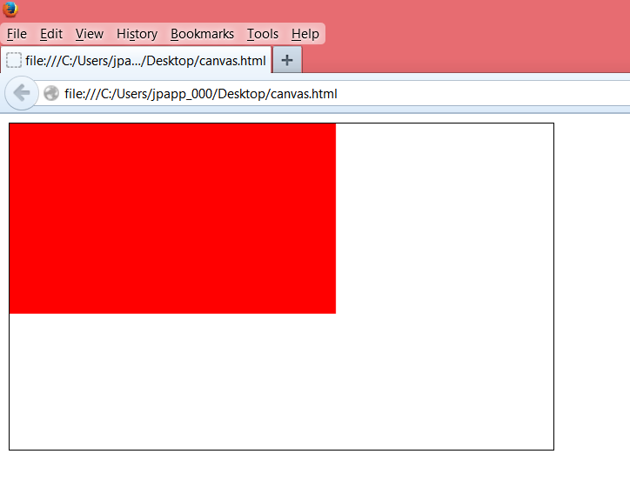
Drawing in Canvas
<script>var c = document.getElementById("myCanvas");
var ctx = c.getContext("2d");
ctx.fillStyle = "#FF0000";
ctx.fillRect(0,0,300,175);
</script>

Slide 7

Linear Animation in Canvas
<script type="application/javascript" language="javascript">
function draw(x,y){
var canvas = document.getElementById('canvas');
var c = canvas.getContext('2d');
c.clearRect(0, 0, 550, 400);
c.fillStyle = "red";
c.fillRect (x, 200, 50, 50);
x+=3;
var looptimer = setTimeout('draw('+x+','+y+')', 20);}
</script>

Slide 8
Linear Animation in Canvas
<script type="application/javascript" language="javascript">
function draw(x,y){
var canvas = document.getElementById('canvas');
var c = canvas.getContext('2d');
c.clearRect(0, 0, 550, 400);
c.fillStyle = "red";
c.fillRect (x, 200, 50, 50);
x+=3;
var looptimer = setTimeout('draw('+x+','+y+')', 20);}
</script>

Slide 9
Advanced Animation
Circular Movement
Spiral Movement
Bouncing
Easing in
Easing out
Gravity
Spring Effect

Slide 10
Amazing Demo

Slide 11
Why use HTML5 and canvas?

Slide 12
Advantages
Develop once, run everywhere. HTML5 Canvas offers great portability. Once created, Unlike Flash and Silverlight, a canvas application can run almost anywhere — from the largest computers to the smallest mobile devices.
Free and accessible development tools. The basic tools for creating HTML5 canvas applications are just a browser and a good code editor. Plus, there are many great and free libraries and tools to help developers with advanced canvas development.

Slide 13





Advantages
Browser/Platform Support. HTML5 Canvas is supported by all major browsers and can be accessed on a wide range of devices including desktops, tablets, and smart phones.

Slide 14
Advantages
Animation. Every object drawn on the canvas can be animated. This allows for all levels of animations to be created, from simple bouncing balls to complex forward and inverse kinematics.

Slide 15
Advantages
Interactivity. Canvas is fully interactive. It can respond to a user’s actions by listening for keyboard, mouse, or touch events. So a developer is not restricted to only static graphics and images.

Slide 16
Advantages
Flexibility. Developers can create just about anything using canvas. It can display lines, shapes, text, images, etc. — with or without animation. Plus, adding video and/or audio to a canvas application is also possible.

Slide 17
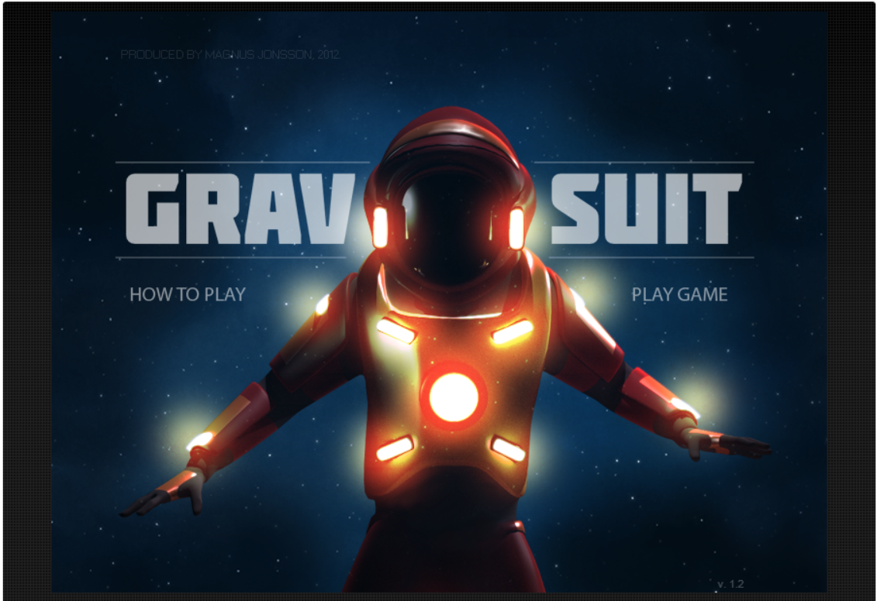
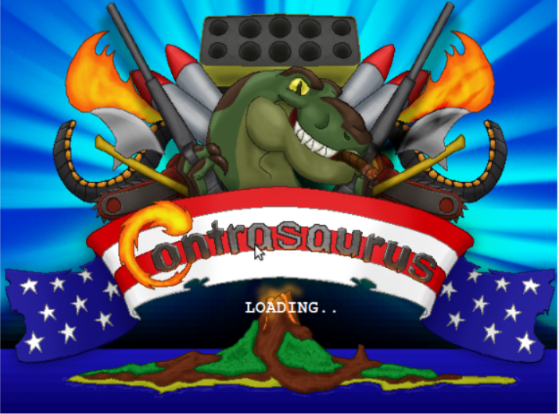
Future Project(s)…

Slide 18
Future Project…

Slide 19

Sources
http://www.google.com
http://www.sitepoint.com/html5-canvas-tutorial-introduction/
https://code.tutsplus.com/articles/21-ridiculously-impressive-html5-canvas-experiments--net-14210
http://davidwalsh.name/canvas-demos
http://www.developphp.com/view.php?tid=1262
http://www.html5code.nl/tutorials/html5-canvas-animations/
http://flavourmachine.com/sesamefighter/
http://www.w3schools.com/HTML/html5_canvas.asp

